Slide 1
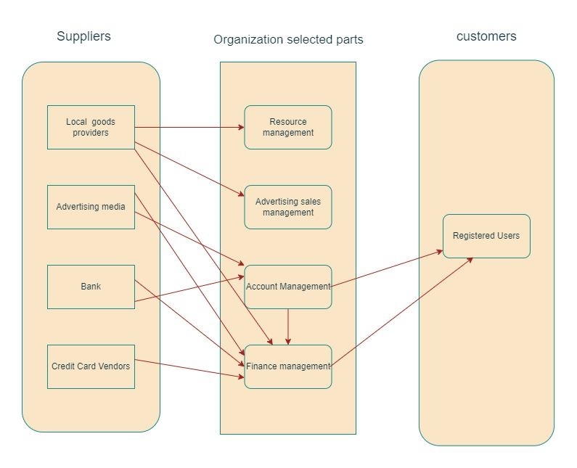
Circular Pie - Business Relation Map

Slide 2
Circular Pie - Business Relation Map
Suppliers
Organization Selected Parts
Customers
Delivery service provider
Resource Management
Customer Support Team
Customers
Raw material suppliers
Partner Restaurants
Business
Management
Payment Gateway
Finance Management
Advertising & Sales Management
Advertising Customers

Slide 3
User Roles by Business Group
External Users (Customers)
Customers (Tharun)
Advertising Customers (Maneesha)
Internal Users
Business Group | User Roles | Team member name (Business group proxy)
Resource Management | Manager | Sarvesh
Advertising Sales & Management | Advertisement Sales Representative | Alan
Business Management | Business Manager | Yash
Finance Management | Accountant | Poonam
Customer Support Team | Customer Relationship Executive | Saichand

